Slide 1
– Independent Demand Inventory Management
Operations Management
by
R. Dan Reid & Nada R. Sanders
3rd Edition © Wiley 2007
© Wiley 2007

Slide 2
Learning Objectives
Describe the different types and use of inventory
Describe the objectives of inventory management
Calculate inventory performance measures
Understand relevant costs associated with inventory
Calculate order quantities
© Wiley 2007

Slide 3
Learning Objectives - Continued
Understand how to justify smaller order sizes
Calculate appropriate safety stock inventory policies
Calculate order quantities for single-period inventory
Perform ABC inventory control and analysis
Understand the role of cycle counting in inventory record accuracy
© Wiley 2007

Slide 4
Types of Inventory
Inventory comes in many shapes and sizes such as
  Raw materials – purchased items or extracted materials transformed into components or products
  Components – parts or subassemblies used in final product
  Work-in-process – items in process throughout the plant
  Finished goods – products sold to customers
  Distribution inventory – finished goods in the distribution system
© Wiley 2007

Slide 5
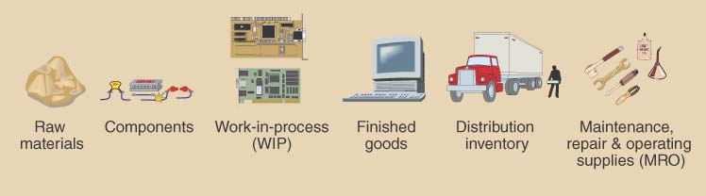
Types of Inventory
© Wiley 2007

Slide 6
Uses of Inventory
Anticipation or seasonal inventory
Fluctuation Inventory or Safety stock: buffer demand fluctuations
Lot-size or cycle stock: take advantage of quantity discounts or purchasing efficiencies
Transportation or Pipeline inventory
Speculative or hedge inventory protects against some future event, e.g. labor strike
Maintenance, repair, and operating (MRO) inventories
© Wiley 2007

Slide 7
Objectives of Inventory Management
Provide desired customer service level
Customer service is the ability to satisfy customer requirements
  Percentage of orders shipped on schedule
  Percentage of line items shipped on schedule
  Percentage of dollar volume shipped on schedule
  Idle time due to material and component shortages
© Wiley 2007

Slide 8
Inventory Management Objectives
Provide for cost-efficient operations:
  Buffer stock for smooth production flow
  Maintain a level work force
  Allowing longer production runs & quantity discounts
Minimum inventory investments:
  Inventory turnover
  Weeks, days, or hours of supply
© Wiley 2007

Slide 9
Customer Service Level Examples
Percentage of Orders Shipped on Schedule
  Good measure if orders have similar value. Does not capture value.
  If one company represents 50% of your business but only 5% of your orders, 95% on schedule could represent only 50% of value
Percentage of Line Items Shipped on Schedule
  Recognizes that not all orders are equal, but does not capture
  $ value of orders. More expensive to measure. Ok for finished goods.
  A 90% service level might mean shipping 225 items out of the total 250 line items totaled from 20 orders scheduled
Percentage Of Dollar Volume Shipped on Schedule
  Recognizes the differences in orders in terms of both line items and
  $ value
© Wiley 2007

Slide 10
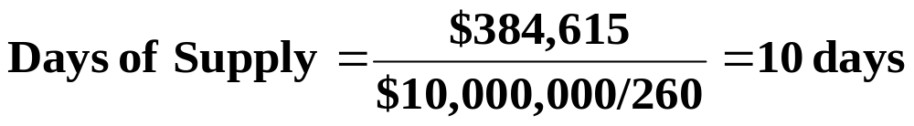
Inventory Investment Measures Example: The Coach Motor Home Company has annual cost of goods sold of $10,000,000. The average inventory value at any point in time is $384,615. Calculate inventory turnover and weeks/days of supply.
Inventory Turnover:
Weeks/Days of Supply:
© Wiley 2007

Slide 11
Relevant Inventory Costs
Item Cost | Includes price paid for the item plus other direct costs associated with the purchase
Holding Costs | Include the variable expenses incurred by the plant related to the volume of inventory held e.g. 15-25%
Capital Costs | The higher of the cost of capital or the opportunity cost for the company
© Wiley 2007

Slide 12
Relevant Inventory Costs
Ordering Cost | Fixed, constant dollar amount incurred for each order placed
Shortage Costs | Loss of customer goodwill, back order handling, and lost sales
Risk costs | Obsolescence, damage, deterioration, theft, insurance and taxes
Storage costs | Included the variable expenses for space, workers, and equipment related to the volume of inventory held
© Wiley 2007

Slide 13
Determining Order Quantities
Lot-for-lot | Order exactly what is needed
Fixed-order quantity | Specifies the number of units to order whenever an order is placed
Min-max system | Places a replenishment order when the on-hand inventory falls below the predetermined minimum level.
Order n periods | Order quantity is determined by total demand for the item for the next n periods
© Wiley 2007

Slide 14
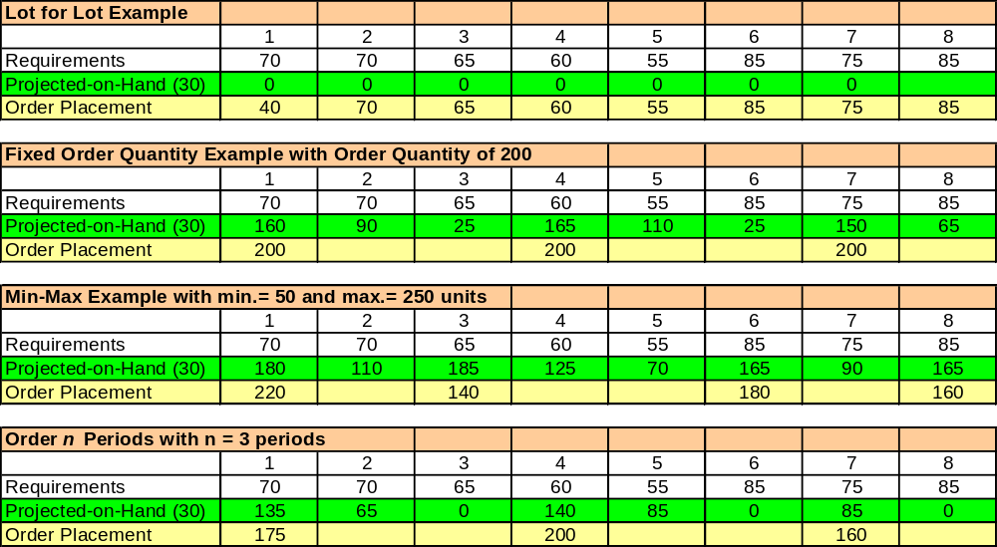
Examples of Ordering Approaches
© Wiley 2007

Slide 15
Three Mathematical Models for Determining Order Quantity
Economic Order Quantity (EOQ or Q System)
  An optimizing method used for determining order quantity and reorder points
  Part of continuous review system which tracks on-hand inventory each time a withdrawal is made
Economic Production Quantity (EPQ)
  A model that allows for incremental product delivery
Quantity Discount Model
  Modifies the EOQ process to consider cases where quantity discounts are available
© Wiley 2007

Slide 16
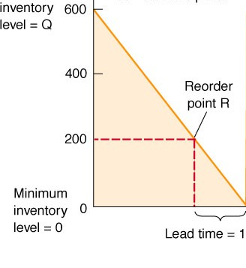
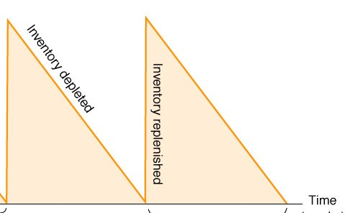
Economic Order Quantity
EOQ Assumptions:
  Demand is known & constant - no safety stock is required
  Lead time is known & constant
  No quantity discounts are available
  Ordering (or setup) costs are constant
  All demand is satisfied (no shortages)
  The order quantity arrives in a single shipment
© Wiley 2007

Slide 17
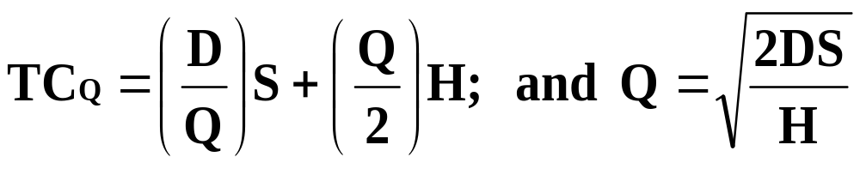
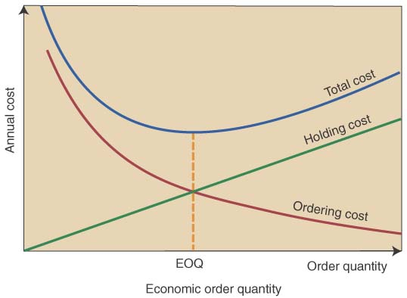
Total Annual Inventory Cost with EOQ Model
Total annual cost= annual ordering cost + annual
holding costs
© Wiley 2007

Slide 18
Reorder point=lead time * avg daily usage also calculate total cycle time “T” number of orders =Annual Demand/Q*
Continuous (Q) Review System Example: A computer company has annual demand of 10,000. They want to determine EOQ for circuit boards which have an annual holding cost (H) of $6 per unit, and an ordering cost (S) of $75. They want to calculate TC and the reorder point (R) if the purchasing lead time is 5 days. Company works for 250 days annually.

Slide 19
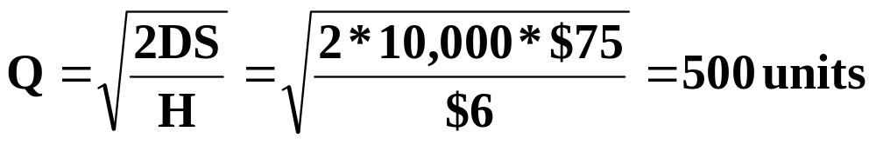
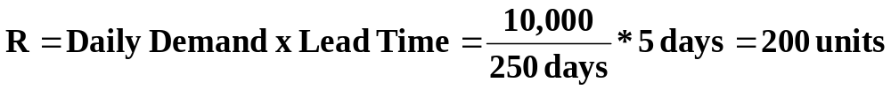
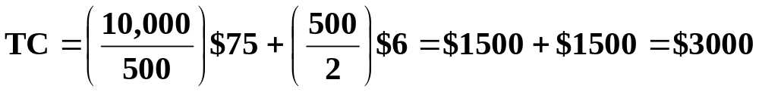
Continuous (Q) Review System Example: A computer company has annual demand of 10,000. They want to determine EOQ for circuit boards which have an annual holding cost (H) of $6 per unit, and an ordering cost (S) of $75. They want to calculate TC and the reorder point (R) if the purchasing lead time is 5 days.
© Wiley 2007

Slide 20
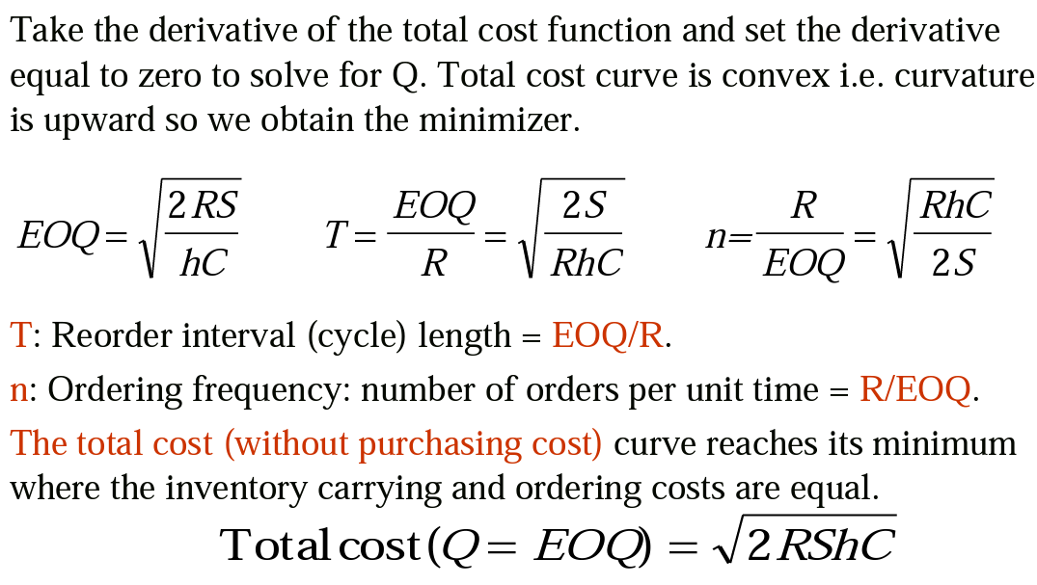
© Wiley 2007

Slide 21
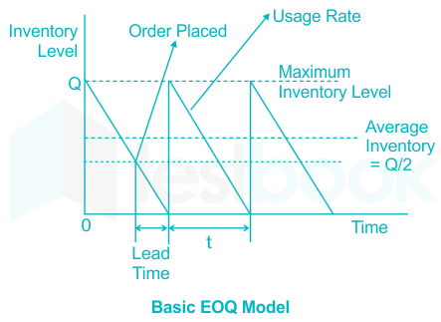
Introduction
1- <number>

Slide 22
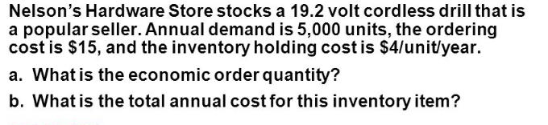
Introduction
1- <number>

Slide 23
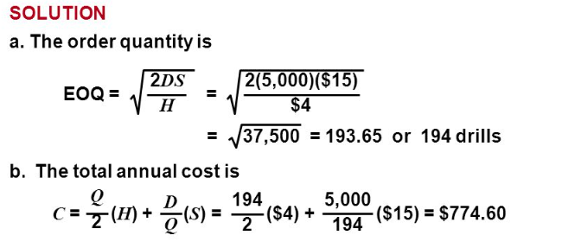
Introduction
1- <number>

Slide 24
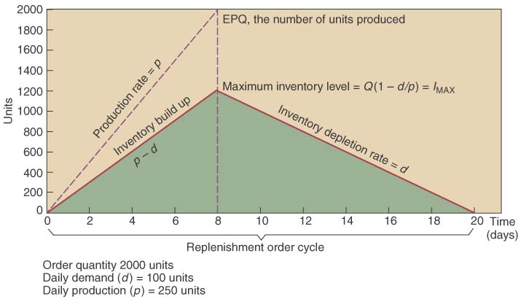
Economic Production Quantity (EPQ)
Same assumptions as the EOQ except: inventory arrives in increments & is drawn down as it arrives
© Wiley 2007

Slide 25
Difference between the EOQ vs EPQ
Both EOQ and EPQ models are inventory-management models and have been implemented successfully across organizations. They are almost similar. The background concept and idea for both are common: to optimize the order or production quantity so that the overall cost of inventory holding remains low.
However, the key difference between the two is that the EOQ model is applied when the inventory item is ordered from a third party. The company itself is not producing the item under consideration.
On the other hand, the EPQ model comes into use when the company is the producer itself of the product or the part under consideration.

Slide 26
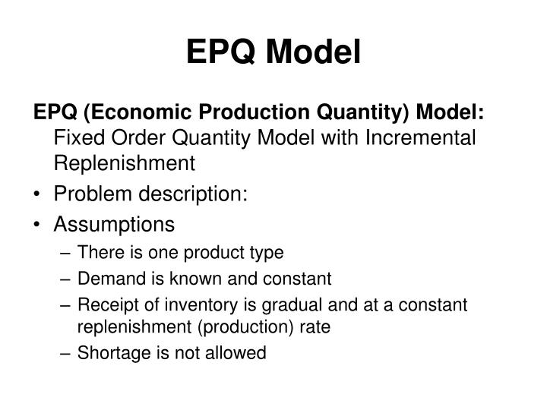
© Wiley 2007

Slide 27
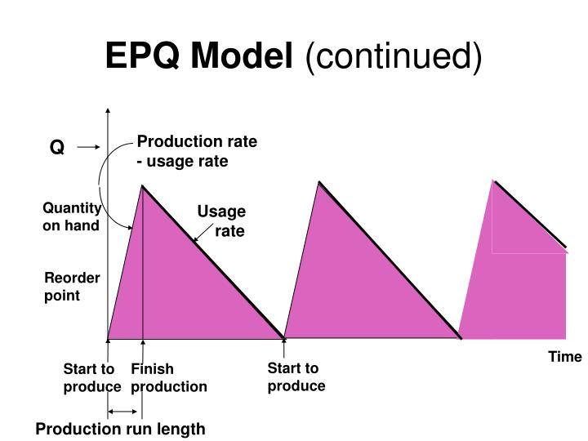
© Wiley 2007

Slide 28
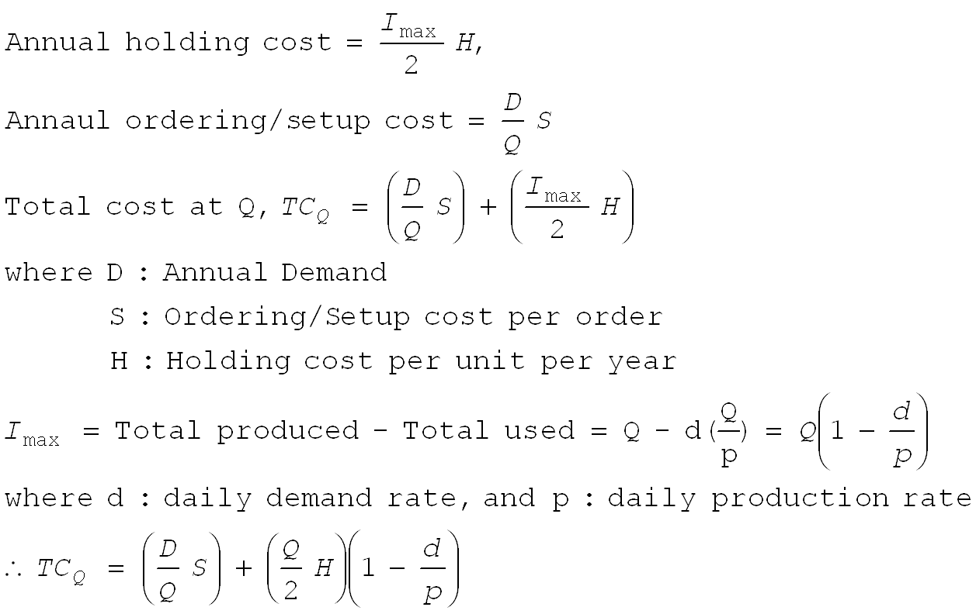
© Wiley 2007

Slide 29
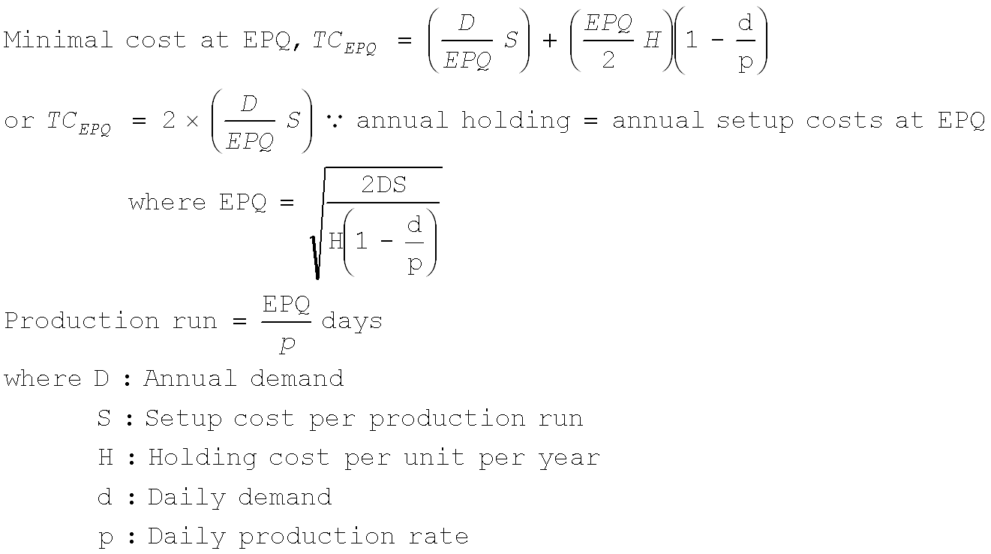
© Wiley 2007

Slide 30
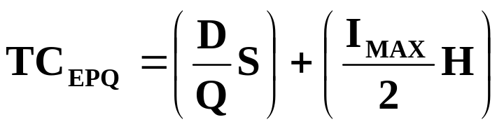
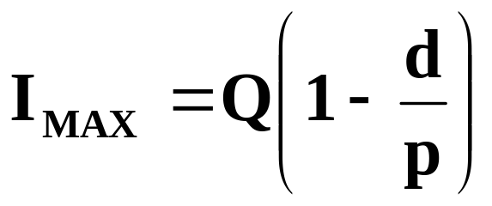
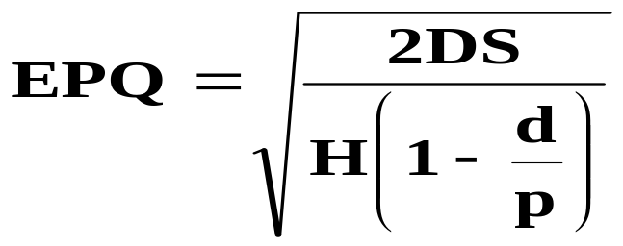
EPQ Equations
Total cost:
Maximum inventory:
  d=avg. daily demand rate
  p=daily production rate
Calculating EPQ
© Wiley 2007

Slide 31
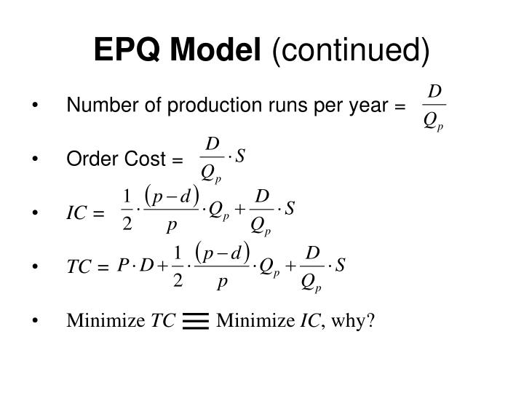
© Wiley 2007

Slide 32
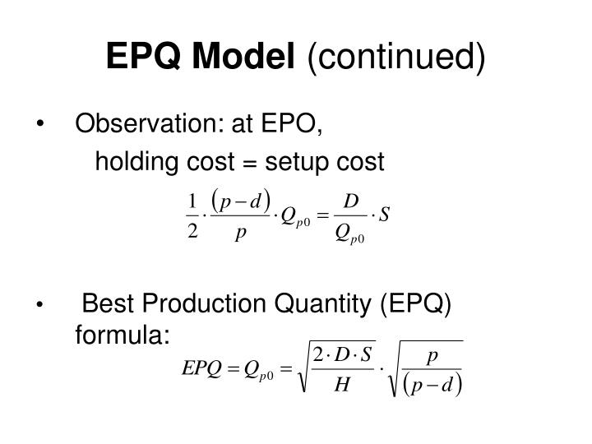
© Wiley 2007

Slide 33
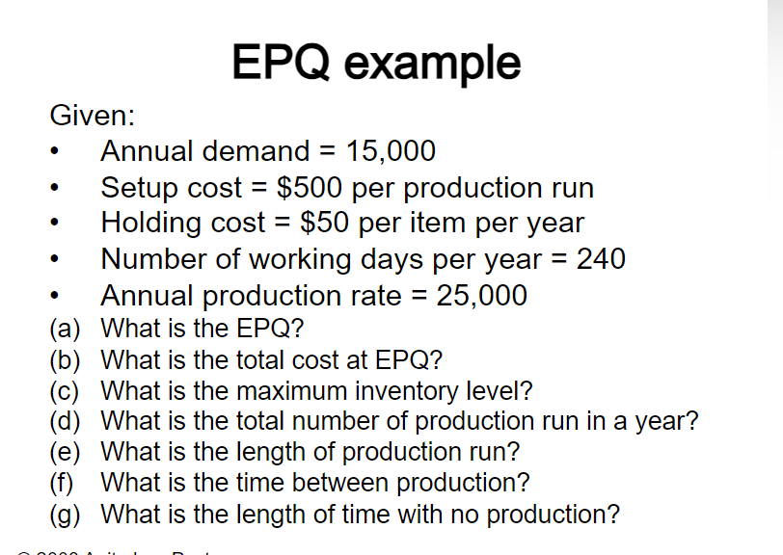

© Wiley 2007

Slide 34
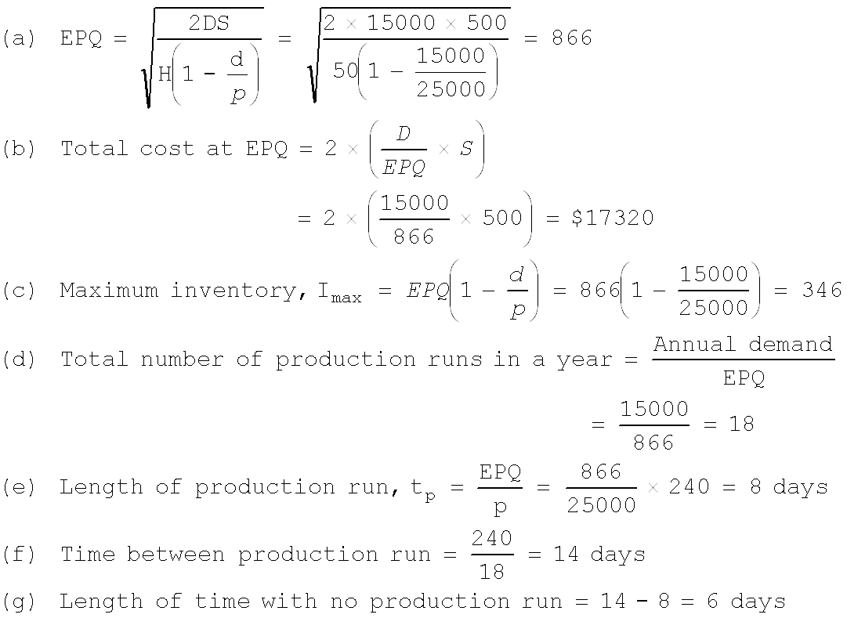

Slide 35
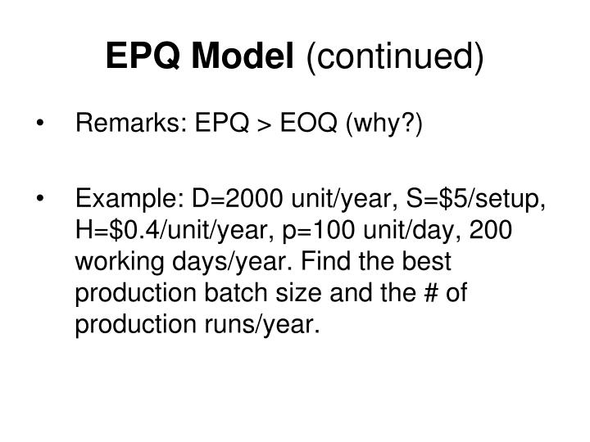
© Wiley 2007

Slide 36
EPQ Problem: HP Ltd. Produces its coking coal in 50 ton rakes. Demand is 100,000 lbs. per week and they operate 50 wks. each year and HP can produce 250,000 lbs. per week. The setup cost is $200 and the annual holding cost rate is $.55 per rake. Calculate the EPQ. Determine the maximum inventory level. Calculate the total cost of using the EPQ policy.
© Wiley 2007

Slide 37
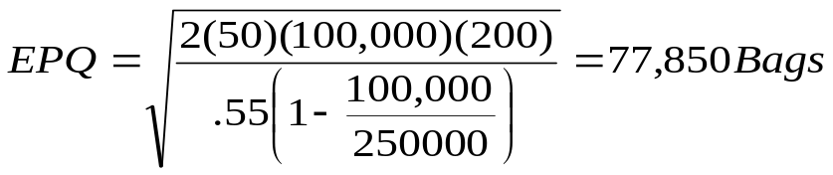
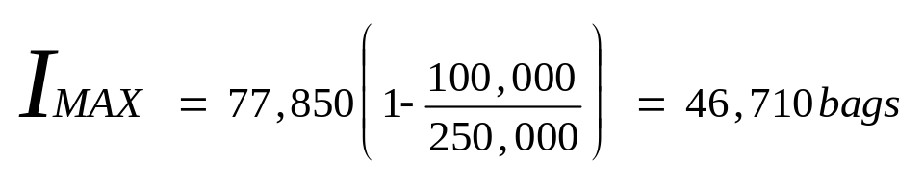
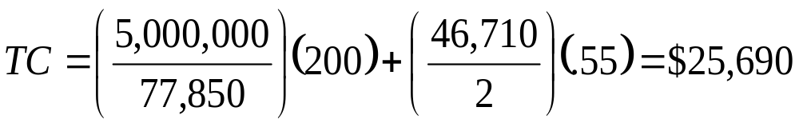
EPQ Problem: HP Ltd. Produces its coking coal in 50 ton rakes. Demand is 100,000 lbs. per week and they operate 50 wks. each year and HP can produce 250,000 lbs. per week. The setup cost is $200 and the annual holding cost rate is $.55 per rake. Calculate the EPQ. Determine the maximum inventory level. Calculate the total cost of using the EPQ policy.
© Wiley 2007

Slide 38
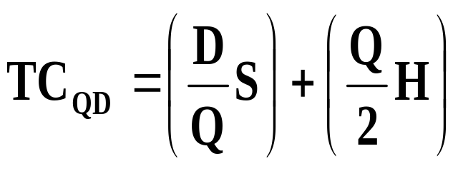
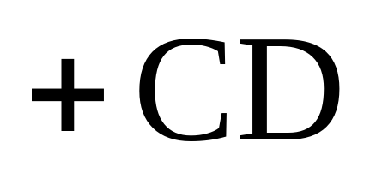
Quantity Discount Model
Same as the EOQ model, except:
  Unit price depends upon the quantity ordered
The total cost equation becomes:
© Wiley 2007

Slide 39
Quantity Discount Procedure
Calculate the EOQ at the lowest price
Determine whether the EOQ is feasible at that price
  Will the vendor sell that quantity at that price?
If yes, stop – if no, continue
Check the feasibility of EOQ at the next higher price
Continue to the next slide ...
© Wiley 2007

Slide 40
QD Procedure (continued)
Continue until you identify a feasible EOQ
Calculate the total costs (including total item cost) for the feasible EOQ model
Calculate the total costs of buying at the minimum quantity required for each of the cheaper unit prices
Compare the total cost of each option & choose the lowest cost alternative
Any other issues to consider?
© Wiley 2007

Slide 41
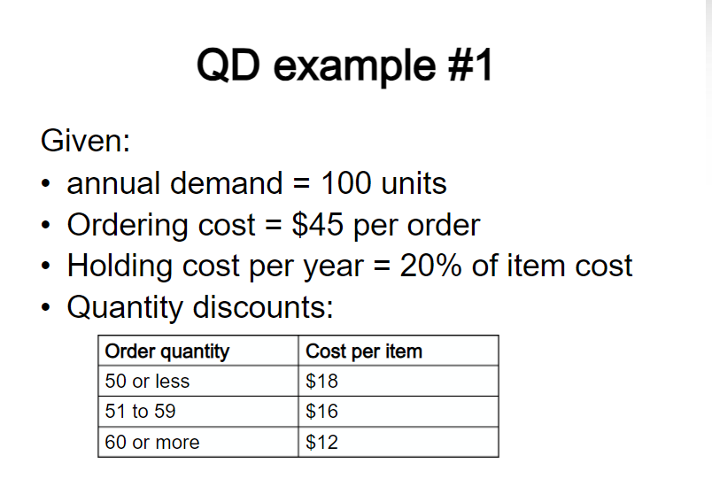

Slide 42
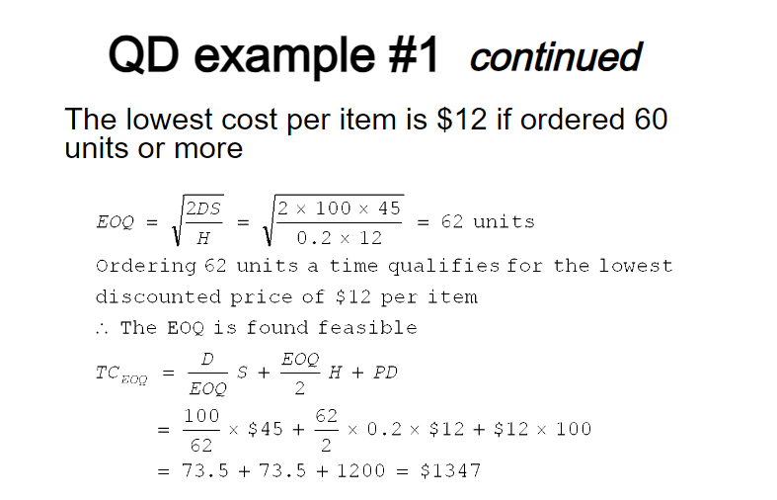

Slide 43
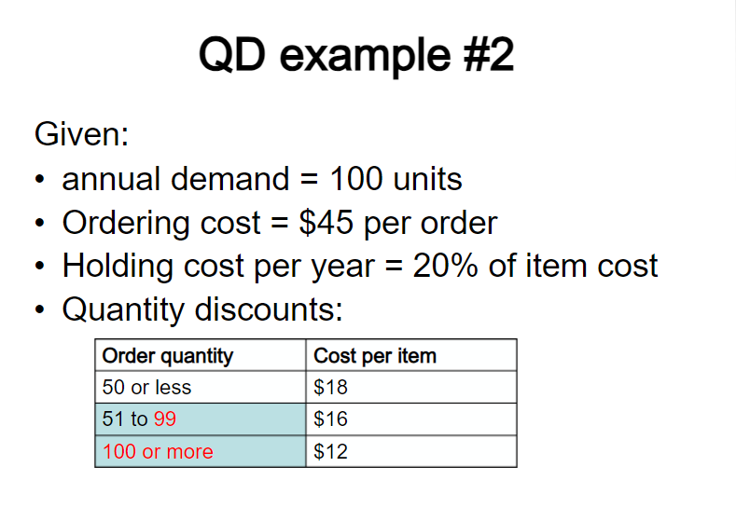

Slide 44
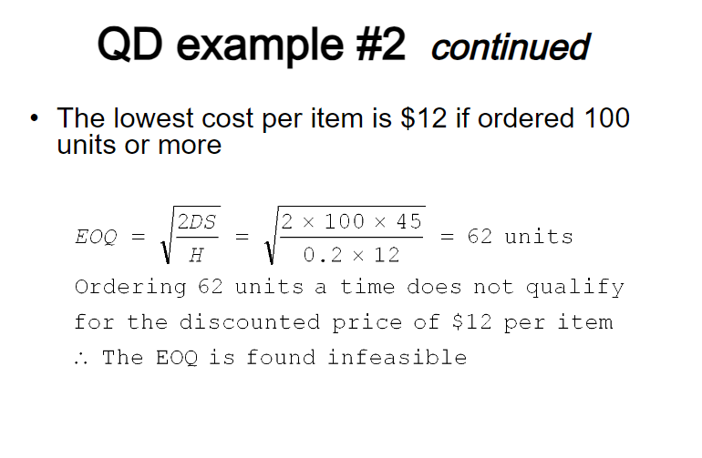

Slide 45
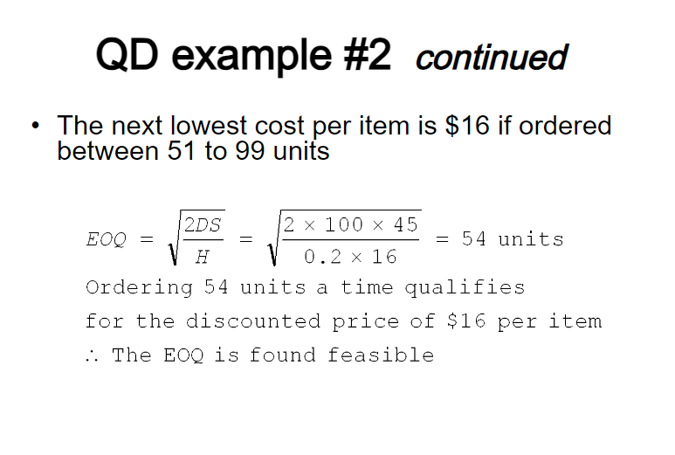

Slide 46
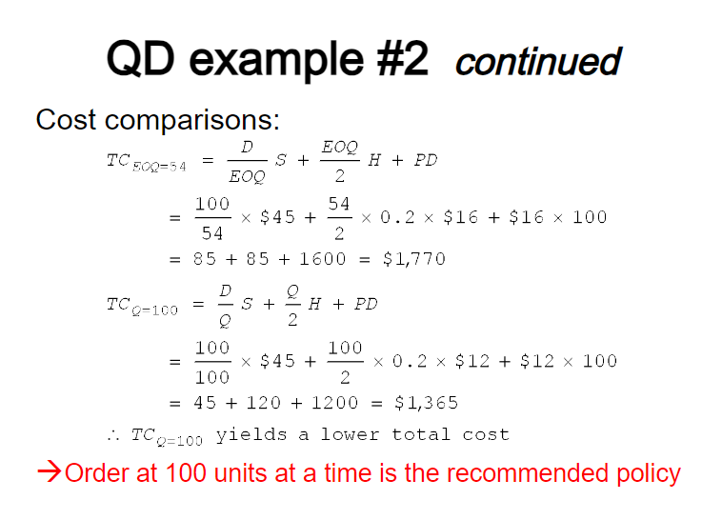

Slide 47
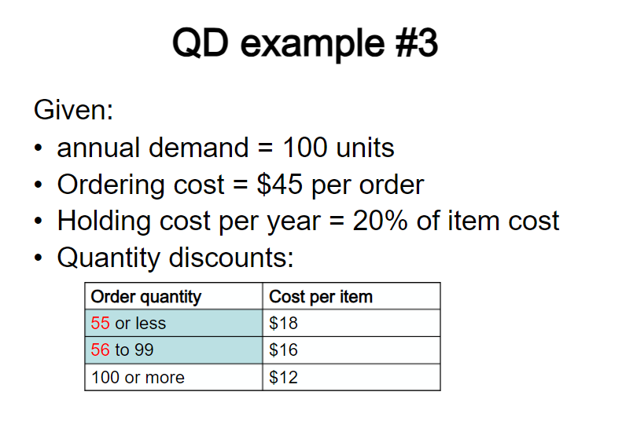

Slide 48
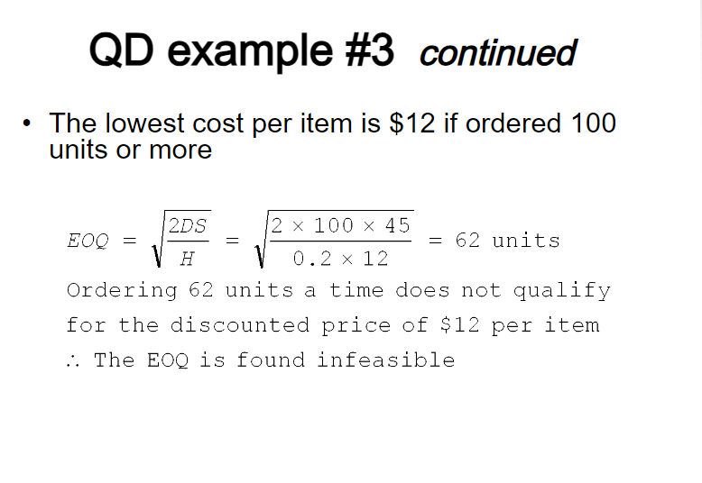

Slide 49
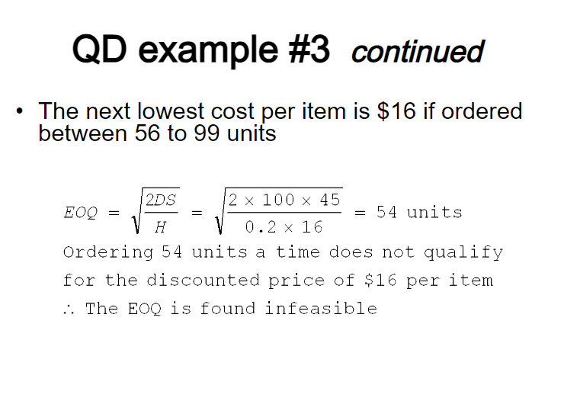

Slide 50
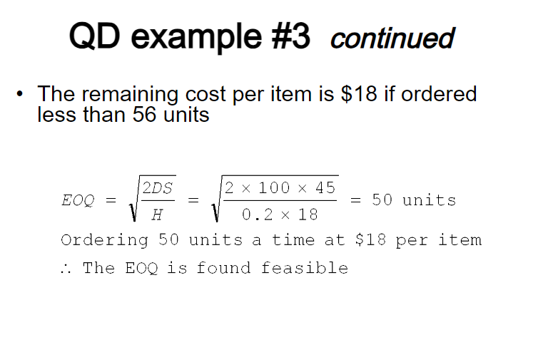

Slide 51
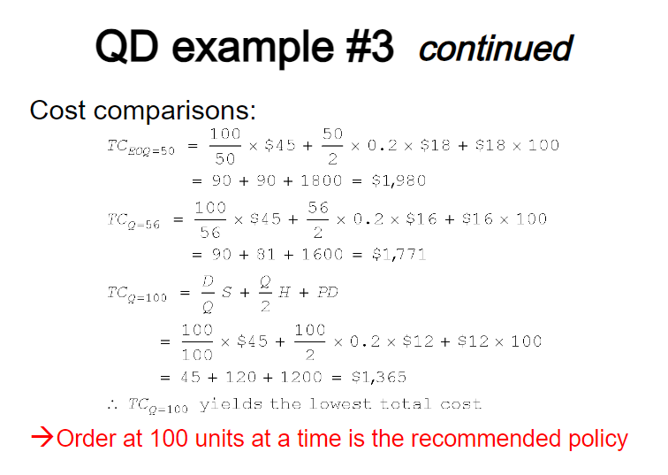

Slide 52
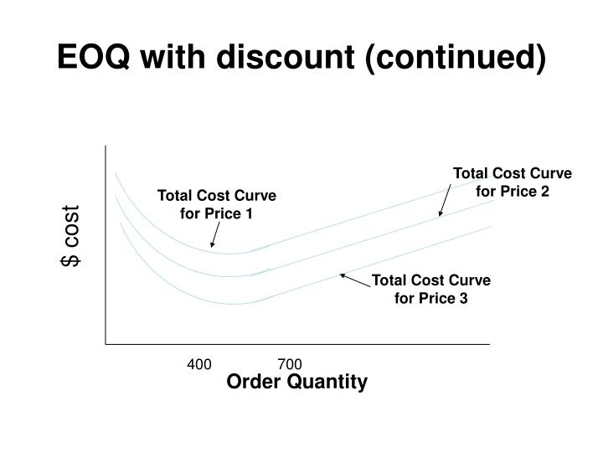

Slide 53
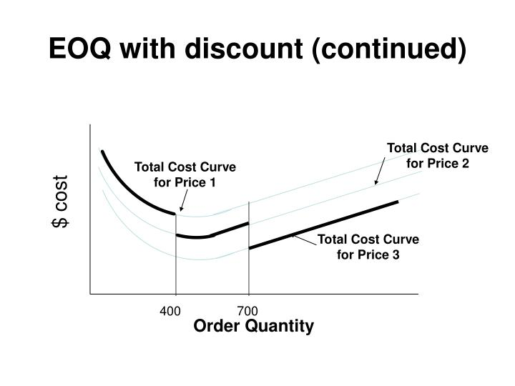

Slide 54
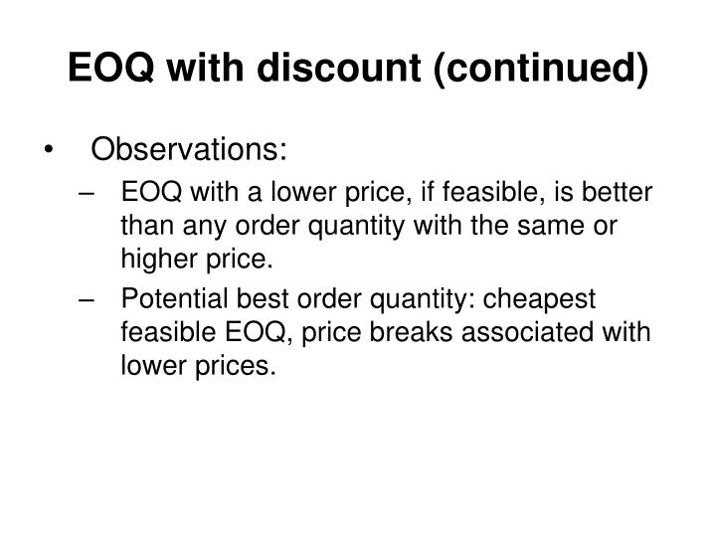

Slide 55
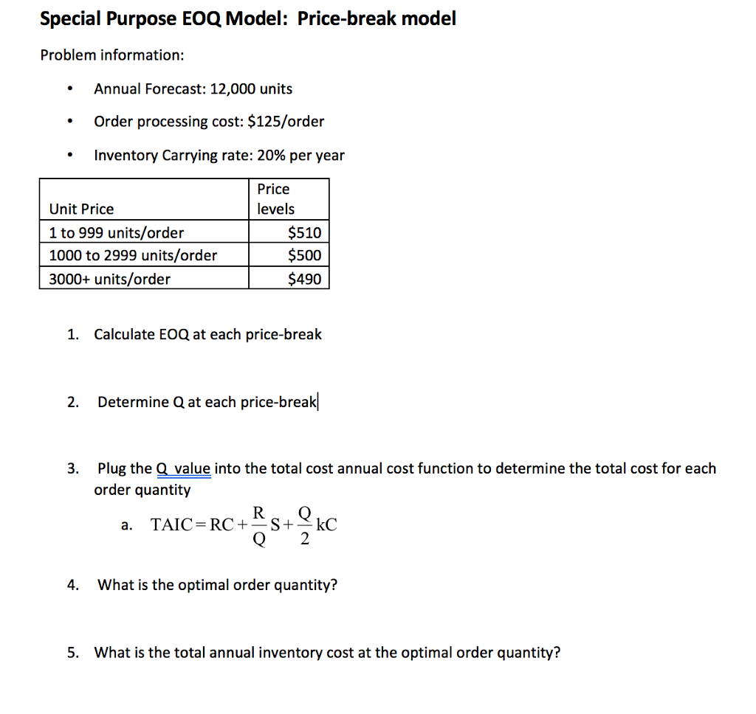
Draw the total cost curve vs. order quantity to explain your answer

Slide 56
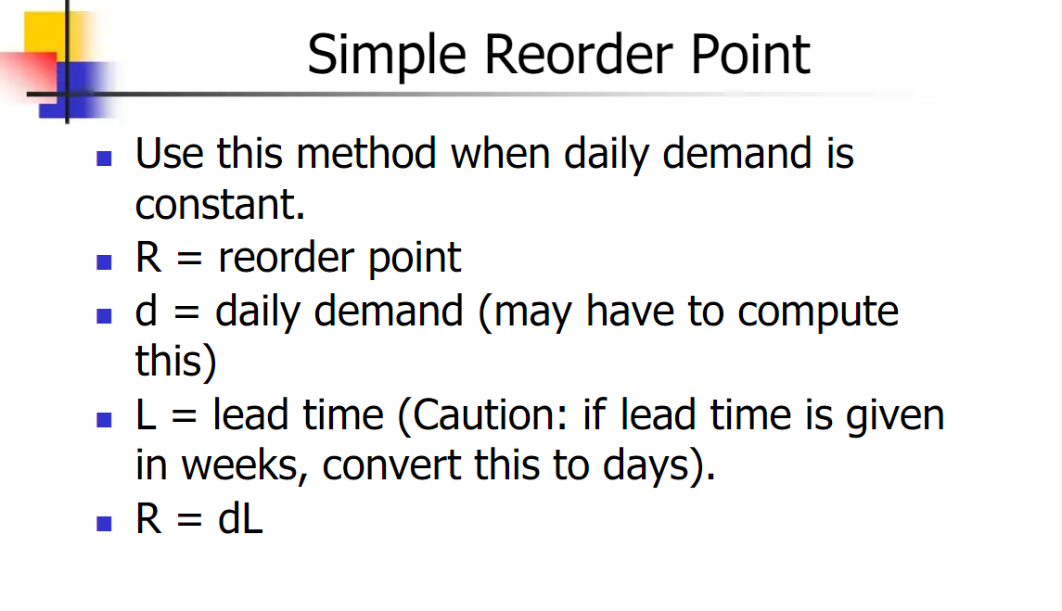

Slide 57
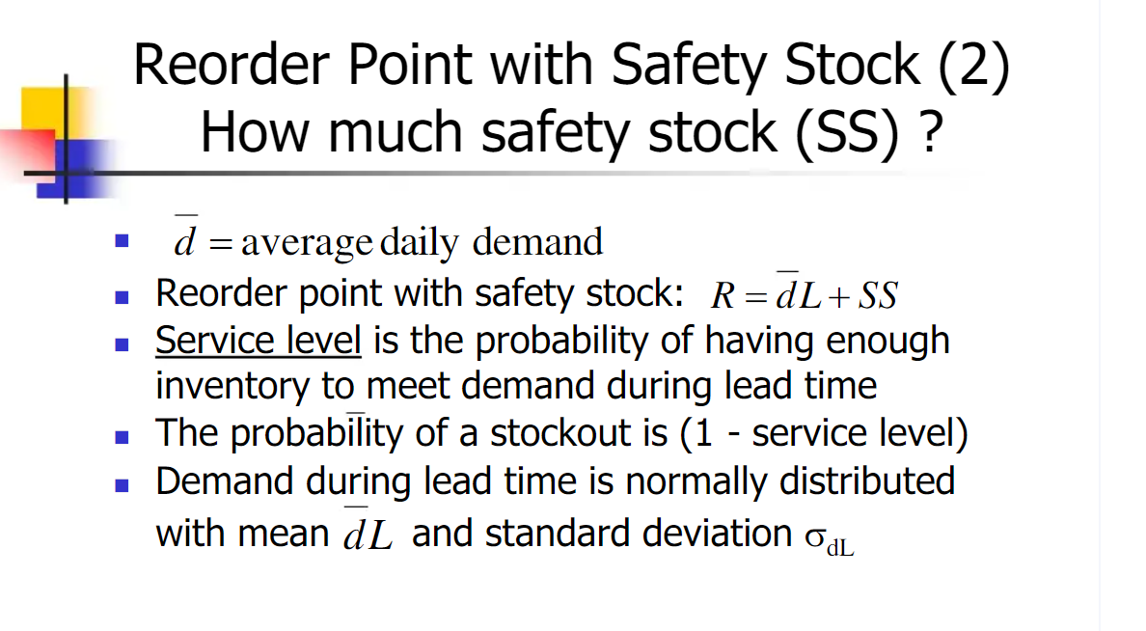

Slide 58
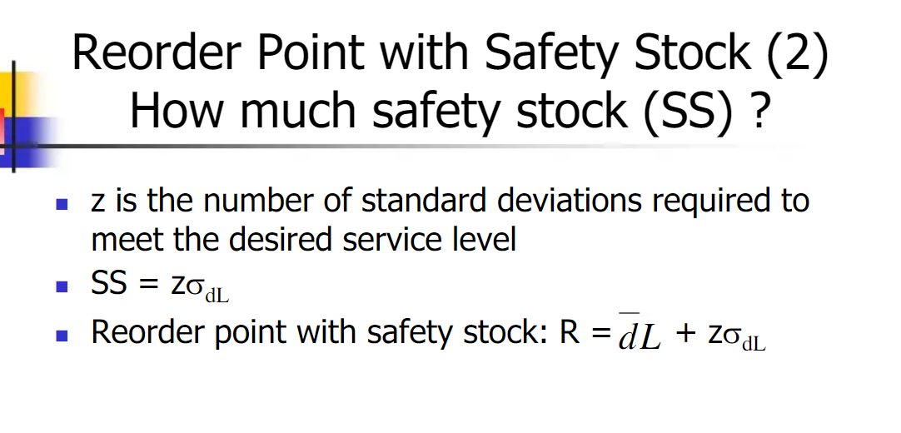

Slide 59


Slide 60


Slide 61


Slide 62


Slide 63


Slide 65


Quantity Discount Example: Collin’s Sport store is considering going to a different hat supplier. The present supplier charges $10 each and requires minimum quantities of 490 hats. The annual demand is 12,000 hats, the ordering cost is $20, and the inventory carrying cost is 20% of the hat cost, a new supplier is offering hats at $9 in lots of 4000. Who should he buy from?
EOQ at lowest price $9. Is it feasible?
Since the EOQ of 516 is not feasible, calculate the total cost (C) for each price to make the decision
4000 hats at $9 each saves $19,320 annually. Space?
© Wiley 2007

Slide 66

Safety Stock and Service Levels
If demand or lead time is uncertain, safety stock can be added to improve order-cycle service levels
  R = dL +SS
  Where SS =zσdL, and Z is the number of standard deviations and σdL is standard deviation of the demand during lead time
Order-cycle service level
  The probability that demand during lead time will not exceed on-hand inventory
  A 95% service level (stockout risk of 5%) has a Z=1.645
© Wiley 2007

Slide 67
Periodic Review Systems
Orders are placed at specified, fixed-time intervals (e.g. every Friday), for a order size (Q) to bring on-hand inventory (OH) up to the target inventory (TI), similar to the min-max system.
Advantages are:
  No need for a system to continuously monitor item
  Items ordered from the same supplier can be reviewed on the same day saving purchase order costs
Disadvantages:
  Replenishment quantities (Q) vary
  Order quantities may not quality for quantity discounts
  On the average, inventory levels will be higher than Q systems-more stockroom space needed
© Wiley 2007

Slide 68
Periodic Review Systems: Calculations for TI
Targeted Inventory level:
TI = d(RP + L) + SS
d = average period demand
RP = review period (days, wks)
L = lead time (days, wks)
SS = zσRP+L
Replenishment Quantity (Q)=TI-OH
© Wiley 2007

Slide 69



P System: an auto parts store calculated the EOQ for Drive Belts at 236 units and wants to compare the Total Inventory Costs for a Q vs. a P Review System. Annual demand (D) is 2704, avg. weekly demand is 52, weekly σ is 1.77 belts, and lead time is 3 weeks. The annual TC for the Q system is $229; H=$97, S=$10.
Review Period
Target Inventory for 95% Service Level
Average On-Hand
OHavg= TI-dL=424-(52belts)(3wks) = 268 belts
Annual Total Cost (P System)
© Wiley 2007

Slide 70
Single Period Inventory Model
The SPI model is designed for products that share the following characteristics:
  Sold at their regular price only during a single-time period
  Demand is highly variable but follows a known probability distribution
  Salvage value is less than its original cost so money is lost when these products are sold for their salvage value
Objective is to balance the gross profit of the sale of a unit with the cost incurred when a unit is sold after its primary selling period
© Wiley 2007

Slide 71
SPI Model Example: Tee shirts are purchase in multiples of 10 for a charity event for $8 each. When sold during the event the selling price is $20. After the event their salvage value is just $2. From past events the organizers know the probability of selling different quantities of tee shirts within a range from 80 to 120
Payoff Table
Prob. Of Occurrence .20 .25 .30 .15 .10
Customer Demand 80 90 100 110 120
# of Shirts Ordered Profit
80 $960 $960 $960 $960 $960 $960
90 $900 $1080 $1080 $1080 $1080 $1040
Buy 100 $840 $1020 $1200 $1200 $1200 $1083
110 $780 $ 960 $1140 $1320 $1320 $1068
120 $720 $ 900 $1080 $1260 $1440 $1026
Sample calculations:
Payoff (Buy 110)= sell 100($20-$8) –((110-100) x ($8-$2))= $1140
Expected Profit (Buy 100)= ($840 X .20)+($1020 x .25)+($1200 x .30) +
($1200 x .15)+($1200 x .10) = $1083
© Wiley 2007

Slide 72
ABC Inventory Classification
ABC classification is a method for determining level of control and frequency of review of inventory items
A Pareto analysis can be done to segment items into value categories depending on annual dollar volume
A Items – typically 20% of the items accounting for 80% of the inventory value-use Q system
B Items – typically an additional 30% of the items accounting for 15% of the inventory value-use Q or P
C Items – Typically the remaining 50% of the items accounting for only 5% of the inventory value-use P
© Wiley 2007

Slide 73

The AAU Corp. is considering doing an ABC analysis on its entire inventory but has decided to test the technique on a small sample of 15 of its SKU’s. The annual usage and unit cost of each item is shown below
© Wiley 2007

Slide 74

(A) First calculate the annual dollar volume for each item
© Wiley 2007

Slide 75

B) List the items in descending order based on annual dollar volume. (C) Calculate the cumulative annual dollar volume as a percentage of total dollars. (D) Classify the items into groups
© Wiley 2007

Slide 76

Graphical solution For Example 12.15 showing the ABC classification of materials
The A items (106 and 110) account for 60.5% of the value and 13.3% of the items
The B items (115,105,111,and 104) account for 25% of the value and 26.7% of the items
The C items make up the last 14.5% of the value and 60% of the items
How might you control each item classification? Different ordering rules for each?
© Wiley 2007

Slide 77

Justifying Smaller Order Quantities
JIT or “Lean Systems” would recommend reducing order quantities to the lowest practical levels
Benefits from reducing Q’s:
  Improved customer responsiveness (inventory = Lead time)
  Reduced Cycle Inventory
  Reduced raw materials and purchased components
Justifying smaller EOQ’s:
Reduce Q’s by reducing setup time (S). “Setup reduction” is a well documented, structured approach to reducing S
© Wiley 2007

Slide 78
Inventory Record Accuracy
Inaccurate inventory records can cause:
  Lost sales
  Disrupted operations
  Poor customer service
  Lower productivity
  Planning errors and expediting
© Wiley 2007

Slide 79
Inventory Record Accuracy
Two methods are available for checking record accuracy
  Periodic counting - physical inventory is taken periodically, usually annually
  Cycle counting-daily counting of prespecified items provides the following advantages:
    Timely detection and correction of inaccurate records
    Elimination of lost production time due to unexpected stock outs
    Structured approach using employees trained in cycle counting
© Wiley 2007

Slide 80
Inventory Management Across the Organization
Inventory management policies affect functional areas throughout
  Accounting is concerned of the cost implications of inventory
  Marketing is concerned as stocking decision affect the level of customer service
  Information Systems is involved to tack and control inventory records
© Wiley 2007

Slide 81
Chapter 12 Highlights
Raw materials, purchased components, work-in-process, finished goods, distribution inventory and maintenance, repair and operating supplies are all types of inventory. Inventories have several uses: anticipation inventory is built before it is needed; fluctuation stock provides a cushion; cycle stock is a result of the company’s ordering quantity; transportation inventory includes items in transit; speculative inventory is a buildup to protect against some future event and MRO inventory supports daily operations
© Wiley 2007

Slide 82
Chapter 12 Highlights
The objectives of inventory management are to provide the desired level of customer service, to allow cost-efficient operations, and to minimize inventory investment. Customer service can be measured in several ways, including as a percentage of orders shipped on schedule, a percentage of line items shipped on schedule, a percentage of dollar volume shipped on schedule, or idle time due to material and component shortages. Cots-efficient operations are achieved by using inventory as buffer stocks allowing a stable year-round workforce, and spreading the setup cost over a larger number of Inventory performance is measured by turns/supply.
Inventory costs include item cost, holding cost, ordering cost, and shortage cost.
© Wiley 2007

Slide 83
Chapter 12 Highlights (continued)
Inventory investment is measured in inventory turnover and/or level of supply. Inventory performance is calculated as inventory turnover or weeks, days, or hours of supply.
Relevant inventory costs include items costs, holding costs, and shortage costs. Holding costs include capital costs, storage costs, and risk costs. Ordering costs are fixed costs for placing an order or performing a setup. Shortage costs included costs related to additional paperwork, additional shipping expense, and the intangible cost of lost customer goodwill.
© Wiley 2007

Slide 84
Chapter 12 Highlights (continued)
Lot-for-lot, fixed-order quantity, min-max systems, order n periods, periodic review systems, EOQ models, quantity discount models, and single-period models can be used to determine order quantities.
Ordering decisions can be improved by analyzing total costs of an inventory policy. Total costs include ordering cost, holding cost, and material cost
© Wiley 2007

Slide 85
Chapter 12 Highlights (continued)
Practical considerations can cause a company to not use the optimal order quantity, that is, minimum order requirements
Smaller lot sizes give a company flexibility and shorter response times. The key to reducing order quantities is to reduce ordering or setup costs.
Calculating the appropriate safety stock policy enables companies to satisfy their customer service objective at minimum costs. The desired customer service level determines the appropriate z value.
© Wiley 2007

Slide 86
Chapter 12 Highlights (continued)
Inventory decisions about perishable products can be made using the single-period inventory model. The expected payoff is calculated to assist the quantity decision
The ABC classification system allows a company to assign the appropriate level of control and frequency of review of an item based on its annual dollar volume
Cycle counting is a method for maintaining accurate inventory records. Determining what and when to count are the major decisions
© Wiley 2007

Slide 87
Chapter 12 Highlights (continued)
Order Q’s can be determined by using L4L, fixed order Q’s, min-max, order n periods, quantity discounts, and single period systems.
Ordering decisions can be improved by analyzing TC
Smaller lot sizes increase flexibility and reduce response time.
Safety stock can be added to reorder point calculations to meet desired service level z value.
Inventory decisions about perishable products can be made by using the single-period inventory model.
ABC analysis can be used to assign the appropriate level of control and review frequency based on the annual dollar volume of each item.
Cycle counting of pre-specified items is an accepted method for maintaining inventory records
© Wiley 2007

